Slide 1
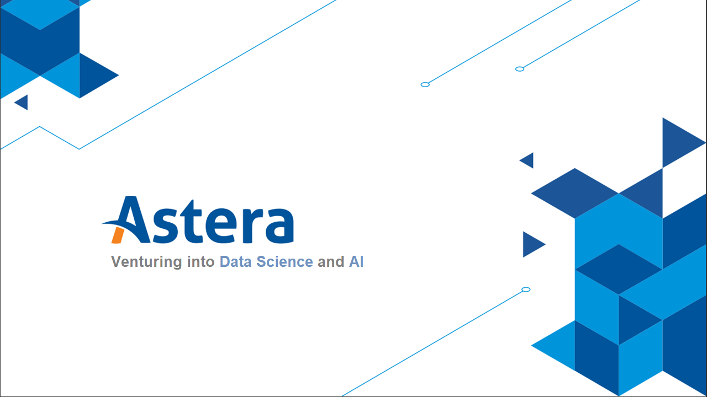

Slide 2
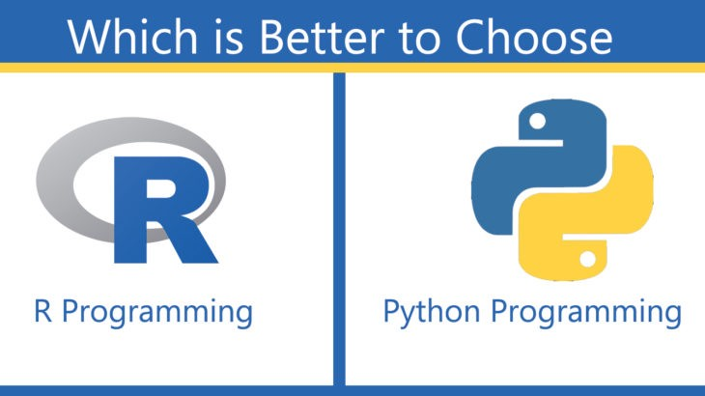
Notes:
More Data Science packages in R than Python!

Slide 3
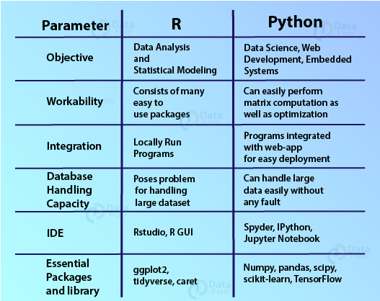
Notes:
R
It was in particular, geared towards addressing the statistical techniques.
R has several graphical libraries like ggplot2 and plotly which make it highly popular owing to quality reports and images that we can generate.
We can use R for several statistical functions like regression, clustering, classification, statistical testing, etc. Therefore, R has a variety of supported operations for machine learning and statistical tasks.
While R suffers from a steep learning curve, it proves to be an ideal language for expressing statistical methodologies, allowing the data scientists to wrangle the data as per their requirements.
R is an open-source programming language meaning that users can actively participate in contributing towards the growing language as well as avail the many benefits without any license.
Being an interpreter-based language, R can run the script immediately and provide output to the user. This allows ease of code debugging.
Python
It is a multi-purpose programming language that we can utilize for a variety of tasks.
Python has a library for every task. From web application development to penetration testing and data science, Python has a solution for everything.
It provides an ample number of libraries that we can avail for various machine learning operations as well as advanced deep learning methodologies.
Python provides a smooth learning curve that makes it highly popular among novices as well as experienced programmers who want to transition into development using Python as their primary language. Due to the vast support libraries, it is becoming the go to choose for many operations as the Python users perceive the language to be the one solution to many problems.
Python is also an open-source programming language that has many open-source projects in which the users can actively contribute.
We can parse the Python scripts and can also run them immediately. Furthermore, we can save Python as compiled programs that can be referenced by other programs.

Slide 4
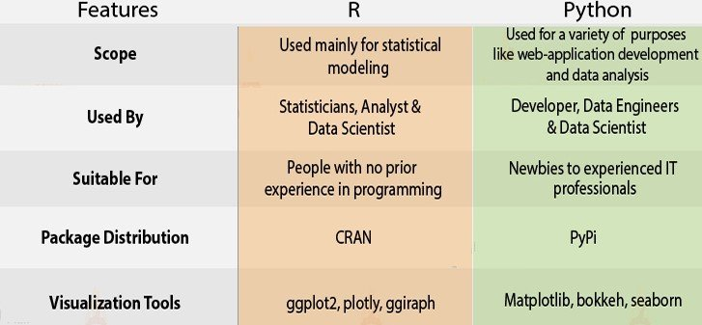
Notes:
Responsibilities of an R Developer are as follows –
An R professional is responsible for providing simulations, carry out data analysis, visualization using a variety of R packages.
An R developer provides assistance in the design and development of the core architecture that will be used in the statistical model.
The developer also coordinates with the end-user for the design and development of the solution to the analytics problems that address the project proposals.
Another key responsibility is to provide data access, manipulate information and report the functions.
Creation of key procedures for integrating R programming with data sources and delivery systems that export the data file in several formats.
An R developer is responsible for providing assistance to the developers for executing their plans while keeping in mind the client requirements.
R programmers have to build a code that consists of a qualitative variable as well as manipulation tasks with several statistical procedures.
Responsibilities of a Python Programmer are as follows –
A Python Developer must be able to implement server-side logic to carry out server-based computations.
Development of asset management software is another key responsibility of a Python programmer.
In order to integrate different software systems, a Python developer must be able to develop a scalable adhesive code.
Writing reusable and testable code for better operational quality is one of the main functions of a Python developer.
Data Security and protection of software is also one of the requirements of a software solution. Therefore, a Python developer must be able to address that.
A Python programmer must be able to implement event-driven programming.
Another important job role is to carry out efficient unit testing and debugging.

Slide 5
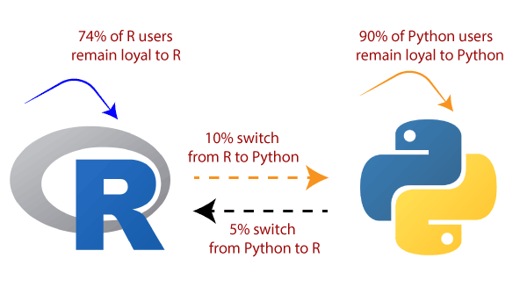
Notes:
Some of the industries that hire R developers are –
Academia
Finance
Banking
Healthcare
Manufacturing
E-commerce
Some of the companies hiring R developers are IBM, Airbnb, Uber, Twitter as well as several public statistical institutes.
Some industries that are hiring Python developers are –
Software Development
Manufacturing
Robotics
Embedded Systems
Automation and Testing
Ethical Hacking
Some of the companies hiring Python developers are Google, Amazon, Dropbox, Quora, Reddit, Pinterest and many more.

Slide 6
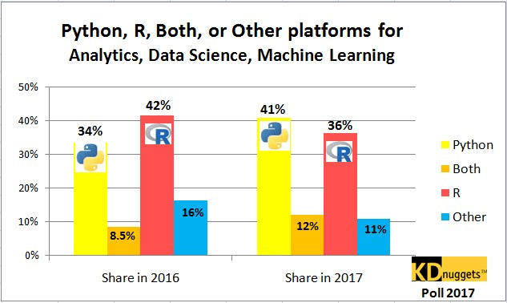
Notes:
Why was Python able to overtake R’s share within a year? Any story behind it?

Slide 7
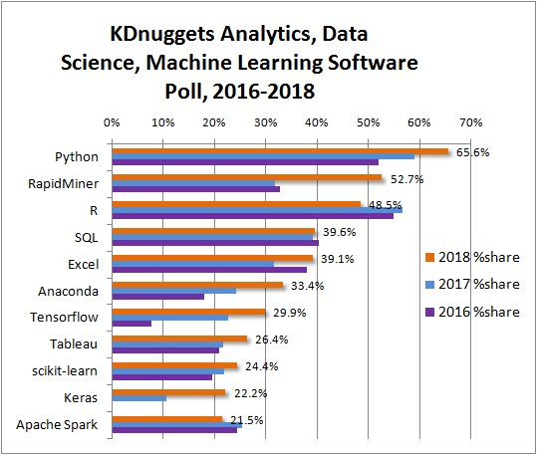
No-Code applications such as RapidMiner and Tableau gained popularity in years 2016-2019

Slide 8
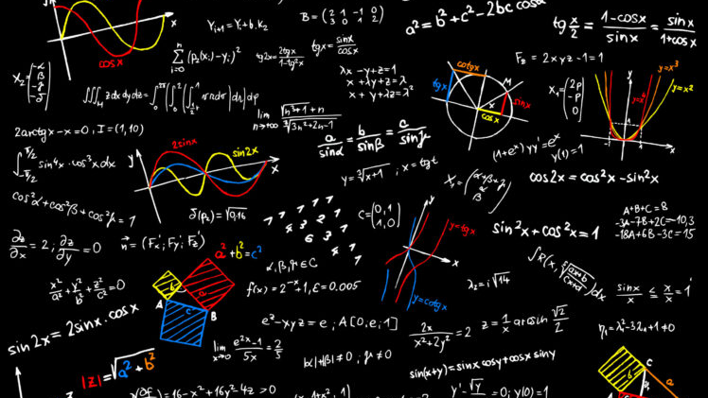

Data Science for Techie People, Then What about Non-Techie? ☹

Slide 9


No-Code Approach
Cleaning data and making predictions can be done without writing a single line of code
Notes:
Data science is a quite complex field to apply a no-code approach, but a few companies have been able to utilize the full power of Data Science such that the tedious work of cleaning data and making predictions can be automated and done without having to write a single line of code.

Slide 10



Benefits of No-Code Approach
Fun & Engaging
Super Fast
Increases Productivity
Notes:
Flexibility to wrangle and process data about 5 times faster than you naturally would, using the traditional method of writing code.
You can literally see engaging visualizations as you clean your data or make predictions from your data.
No-code approach increases productivity with work since work can be done so fast and focus can be centered on a specific task at a time. Not wasting time in resolving syntax errors

Slide 11
Why No-Code Data Science is the future?
As little as one-quarter of 1% of the world knows how to code.
Low code/no-code solutions have the potential to reduce the development and implementation time by 90%.
Global no-code market is predicted to generate a revenue of $187 billion by 2030, rising from $10 billion in 2019. (source: GlobeNewswire)

Slide 12


Resources
To learn Python: https://www.w3schools.com/python/default.asp
To learn Data Science:
https://www.w3schools.com/datascience/default.asp
To learn Theory behind Statistics and Machine Learning:
https://www.youtube.com/@statquest/videos

Slide 13

Quiz - 01

Slide 14
Setting up DataPrep and Analytics Workbench

Slide 15

THANK YOU
Training and Certification

